Slide 2
Azure Deep Dive
Rob Bell

Slide 3
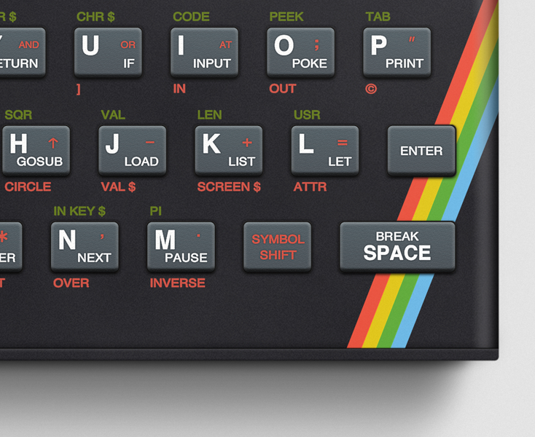
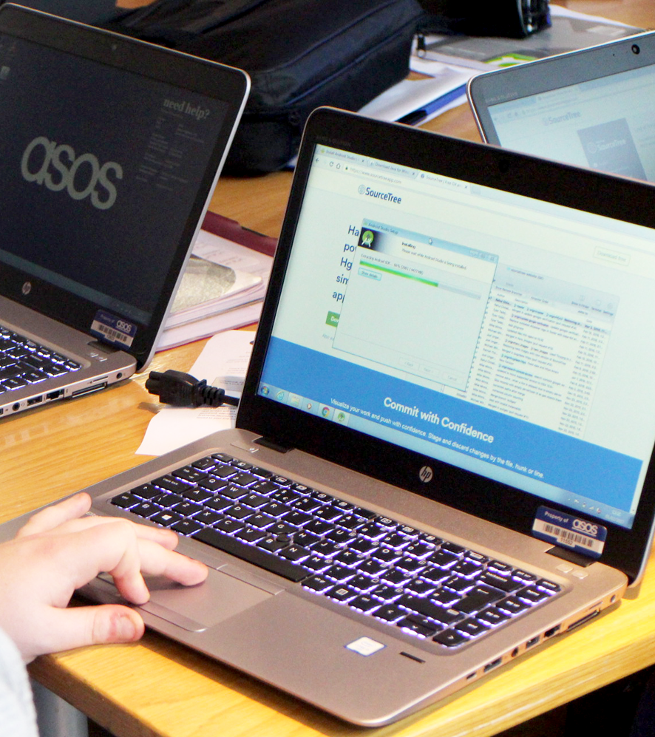
Rob Bell
Lead Software Engineer
Over 20 years writing code and over a decade as a professional developer
First code I wrote was for the ZX Spectrum
After that, I worked my way through the book The C Programming Language
Built HTML web pages in Microsoft Frontpage on my first PC
Since then I’ve written code in C++, Java, JavaScript, PHP, Delphi, Coldfusion, C#, VB, Scheme, F#...
Notes:
Over 20 years writing code and over a decade as a professional developer
I wrote my first code for my uncle’s ZX Spectrum, in a language called Basic – question to room
I worked my way through the book The C Programming Language, I wrote code samples on pencil and paper as I didn’t have a computer at the time
When I finally did get my first PC, I built web pages in HTML using Microsoft Frontpage
Since then I’ve written code in C++, Java, JavaScript, PHP, Delphi, Coldfusion, C#, VB, Scheme, F#...

Slide 4

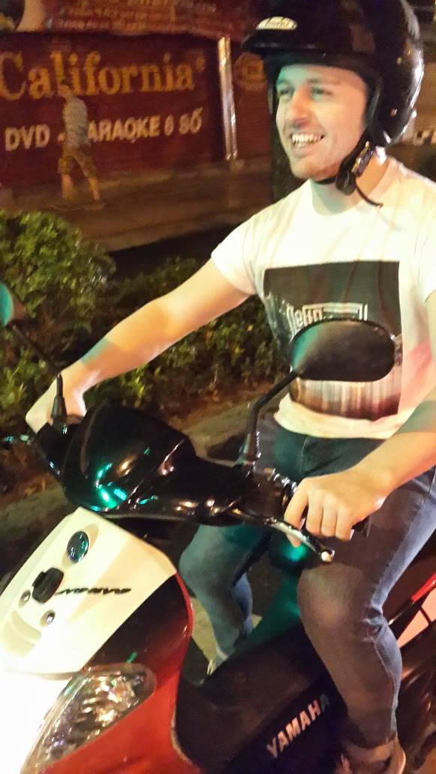
Rob Bell
Lead Software Engineer
My first job as a developer was for a media company, before moving into the insurance and finance sector
Built a software development team in Vietnam
Moved back home and had a brief stint as a technical architect
Moved to ASOS where I work for the Asset and Sizing platforms
Notes:
My first job was for a small media company which was also a charity
Small team of three devs, great freedom to build whatever we thought would help the organisation
Podcasting, with audio coming straight from the studios
After that I moved into insurance and finance
Code audits, lots of bureaucracy
After a few years there I got the opportunity to start a development team in Vietnam

Slide 5
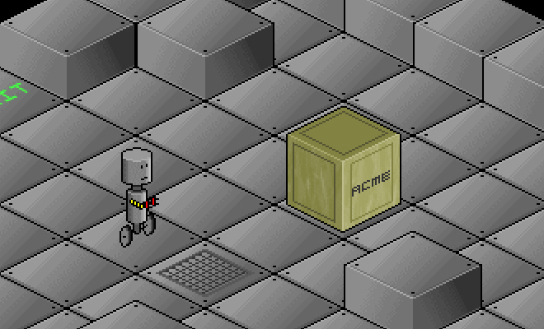
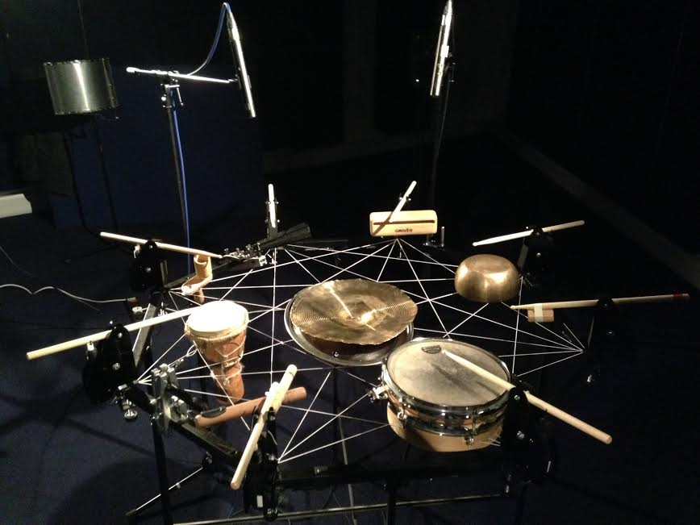
Rob Bell
Lead Software Engineer
Side projects include:
Creating games
Hackathons
Writing code to power sound and light installations
Building robot drum machines
I blog about some of it at rob-bell.net
Notes:
In my spare time I’ve built games and I’ve written code to power sound and light installations and robot drum machines
The game is called Rob-O-Tronic and it’s a slide puzzle, written as part of my dissertation at university
The drum machine was programmed by visiting a website and entering a musical score
It was on display at the Natural History Museum and the V&A
I blog about some of it at rob-bell.net

Slide 6
Part 1: Azure Resources

Slide 7
Why use the cloud?
“Cloud computing is just using somebody else’s computers”
Notes:
Put the question out to the team
It is correct, but a very simplistic view
Cloud computing provides so much more

Slide 8
Information technology as a utility, not a burden
Notes:
Electricity as an example
Everyone running their own generators requires lots of time, skill
Less reinventing the wheel – quote
Pay for what you need

Slide 9
Why use the cloud?
Availability
Flexibility
Security
Maintenance
Notes:
Availability – self healing.
Server failures, another takes over. Datacentre failures, another takes over.
Geo-located
Flexibility
Both scalability (up and down, out and in) and density options
Move resources to regions where they're required
Security
Microsoft’s experience of securing services, many experts, combined knowledge
Specialist tools not available in on-premise scenarios
Maintenance
Patching, disk changes, other hardware, downtime, server moves, everything tied to a specific piece of hardware
Share the story of the old GS2 image servers at ASOS

Slide 10
Why use the cloud?
AI
Intelligent Services
Planet-Scale Databases
Notes:
Cloud-only services
Planet-scale databases
AI services
Cognitive service – speech, vision
Less re-inventing the wheel

Slide 11
Why Azure?
“Microsoft are money-grabbing *********s”
Notes:
Put question to group
Microsoft’s recent move to be open first, developer friendly

Slide 12
Why Azure?
Familiarity
Cost
Resources
Notes:
Familiarity for .NET engineers, languages and resource types, lift and shift => Iaas to Paas to Saas
Certain services very affordable, Windows licences subsidised
Range of resources available is more than competitive with other cloud providers
Cognitive services only available via the cloud
AI used by Uber
Cognitive services including vision and speech
Global scale databases
Customers include:
Apple iCloud – cloud storage and other services
eBay – web app
Adobe – online services
Ubisoft - games
Samsung - IoT
Government agencies – compliance levels – Azure Stack to use Azure concepts on-premise

Slide 13
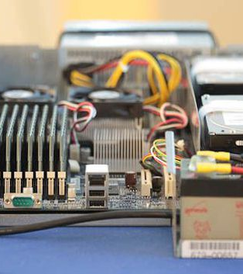
Compute Options
But I just want to run ‘Hello, World’!
Virtual Machines (VMs)
VM Scale Sets
Cloud Services
App Services
Service Fabric
Containers
Container orchestrators
Azure Functions
Probably a dozen more since creating this slide…
Notes:
VMs – complete control over the machine (IaaS)
SS – ability to scale and replicate reliably
Cloud Services – MS’s first attempt at PaaS – forget about the OS and runtime to some degree
App Services – MS’s next attempt at PaaS
Service Fabric – introduces orchestration, somewhat PaaS, introduces some of its own concepts too – “reliable services” – also supports containers…
Containers – somewhere between Iaas and Paas – but introduce packaging of applications, isolation
Orchestrators – handle running multiple containers
Azure Functions – functions as a service – stateless, very scalable, fixed paradigm

Slide 14
Databases
DELETE FROM OrderInformation
-- WHERE Id = 582
SQL Azure -
CosmosDB
Notes:
SQL Azure – managed version of SQL server
CosmosDB
NoSQL database
Schemaless
Huge scale
Multi-paradigm
Mutliple consistency, latency options

Slide 15
Service Bus
Why this is important in a MicroServices architecture

Slide 16
App Insights

Slide 17
Other things

Slide 18
Labs

Slide 19
Part 2: Cloud Design Patterns

Slide 21
Labs

